Slide 1



wargen guittap
neil himes
juan uscanga
VizNet: The Network Visualizer
john inductivo
bryan nunez
kai t. sleight
sedachael zeleke

Slide 2



businesses are losing...
61% of businesses reported cyber attacks
Costing an average of $369,000
Average of $200,000 without outliers
600% increase from 2018 losses
Notes:
In 2019, the Hiscox Cyber Readiness Report (This report gauges how well business are prepared for handling breaches and cyber incidents)1 surveyed 5,400 firms and reported that 3,300 or about 61% reported an attack costing these businesses an average of $369,000. Now this number is huge, but obviously there are going to be some outliers - big businesses with huge losses that will skew the average. But when we take out those outliers, we still get an average loss of $200,000 per business which is almost a 6x increase from 2018’s number of $34,000.

Slide 3

and they are not preventing it!
Breaches for small businesses go up from 33% to 47%
Only 28% rated their ability to mitigate threats as “highly effective”
Notes:
In this same report, the number of breaches for small businesses went up from last year's 33% to 47% this year. With this increase in the number of breaches you would expect that these small businesses would be much better prepared for data breaches. In 2018, Ponemon Institute2 (institute who conducts research that advances the privacy management practices within business’) surveyed 1,040 people from a variety of industries (Finance, Retailing, Services, etc.) and only 28 percent of the companies represented rated their ability to mitigate threats as “highly effective”.

Slide 4

prevention with observance
$5.2 trillion in losses between the years of 2019 and 2023
Have business owners observe the devices on their network
Notes:
Cyber-attacks are getting more widespread and costing businesses more and more financially. According to Accenture3 (global professional services company who specializes in security), if businesses do not do more to prevent these attacks the total value at risk is $5.2 trillion globally between the years of 2019 and 2023. What do we do to prevent it? One approach is for small business owners to routinely monitor and scan any device that’s on the network.
Norbert Nthala (MSU researcher who specializes in information security) 4 et al. found that “prioritizing efforts on critical points in the home network infrastructure and developing appropriate tools to help home users with assessment, protection, monitoring, and incident response is a viable option.” This quote shows the importance of small business owners having an application which will observe the devices on the network and detect any that are not recognizable or have open ports.The issue is this has been done before and done in several different ways (good place to do the device comparison).

Slide 5

observation of competitors
Advantages
extensive list of features and tools
suitable for intermediate or advanced users
Disadvantages
Lack any description or additional information about a feature
overwhelming to look at
minimal customization
Less accessible
Notes:
In observation of competitors we gathered a list of perceived advantages and disadvantages based on testing done by team members. A list of advantages and disadvantages provided key points for constructing our application.
Competitive network scanners and managers analyzed during our research phase showcased extensive information and features viewable to the user but lacked an educational aspect for users less versed in technical terminology and network management. (next slide 6)
An Android application, Network Manager performed exceedingly well in retrospect with the quality of network information accessible and in-depth visuals of the network topology and network traffic. (next slide 7) Nmap provides network scanning features using command line input on Linux systems but is less accessible than a mobile device application.
These extensive features provide knowledgeable users the access needed to visualize public networks and manage their private network but can be overwhelming to beginners learning how to interact with networks.

Slide 6
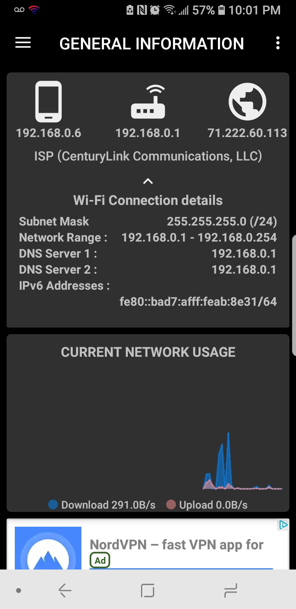
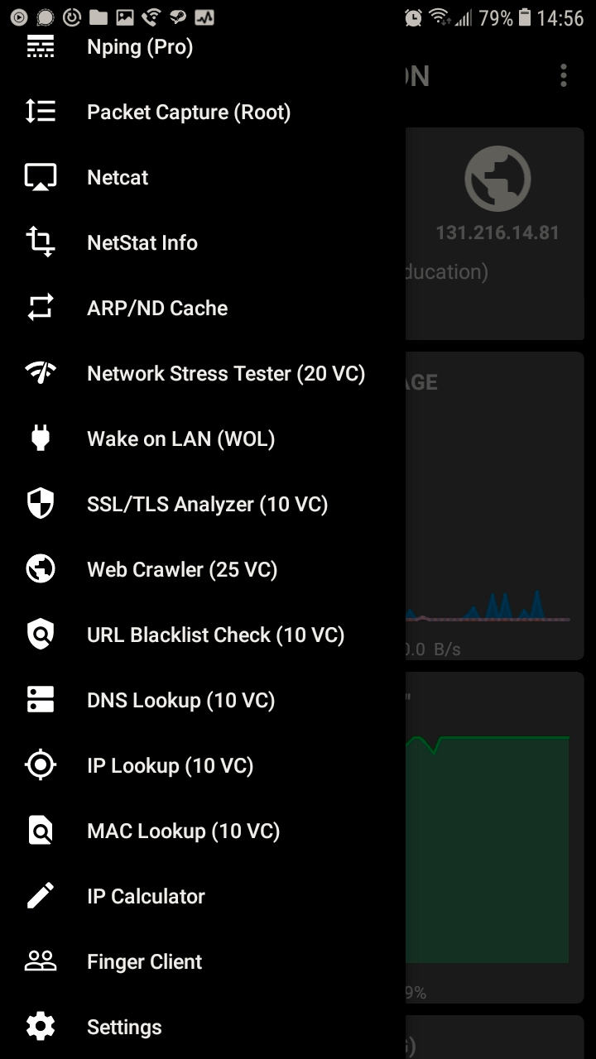
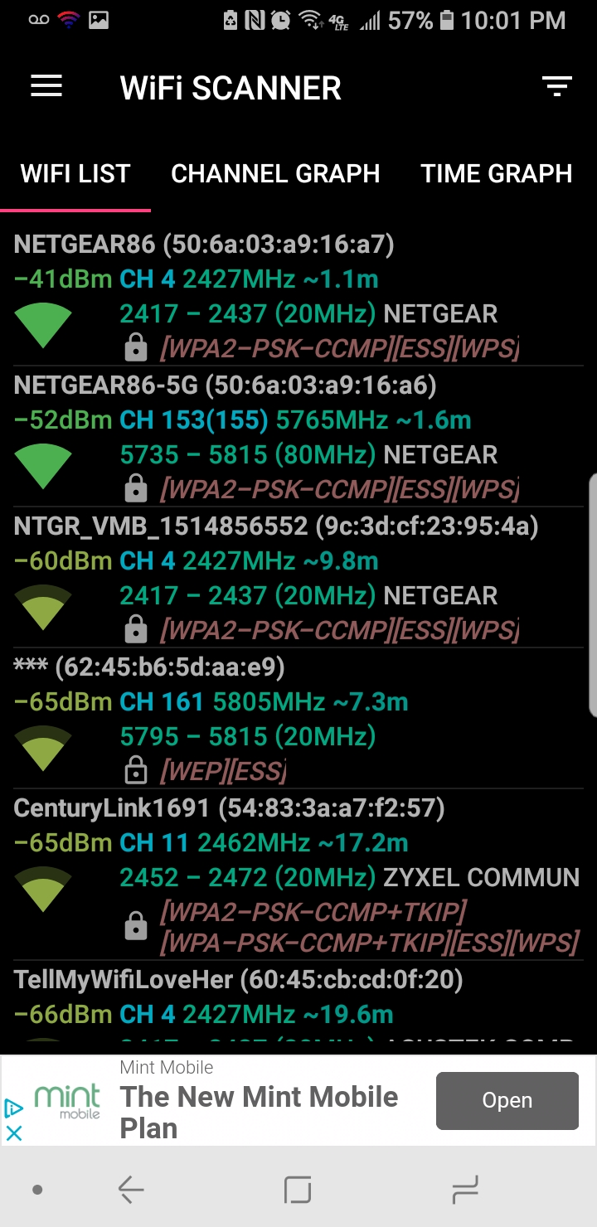
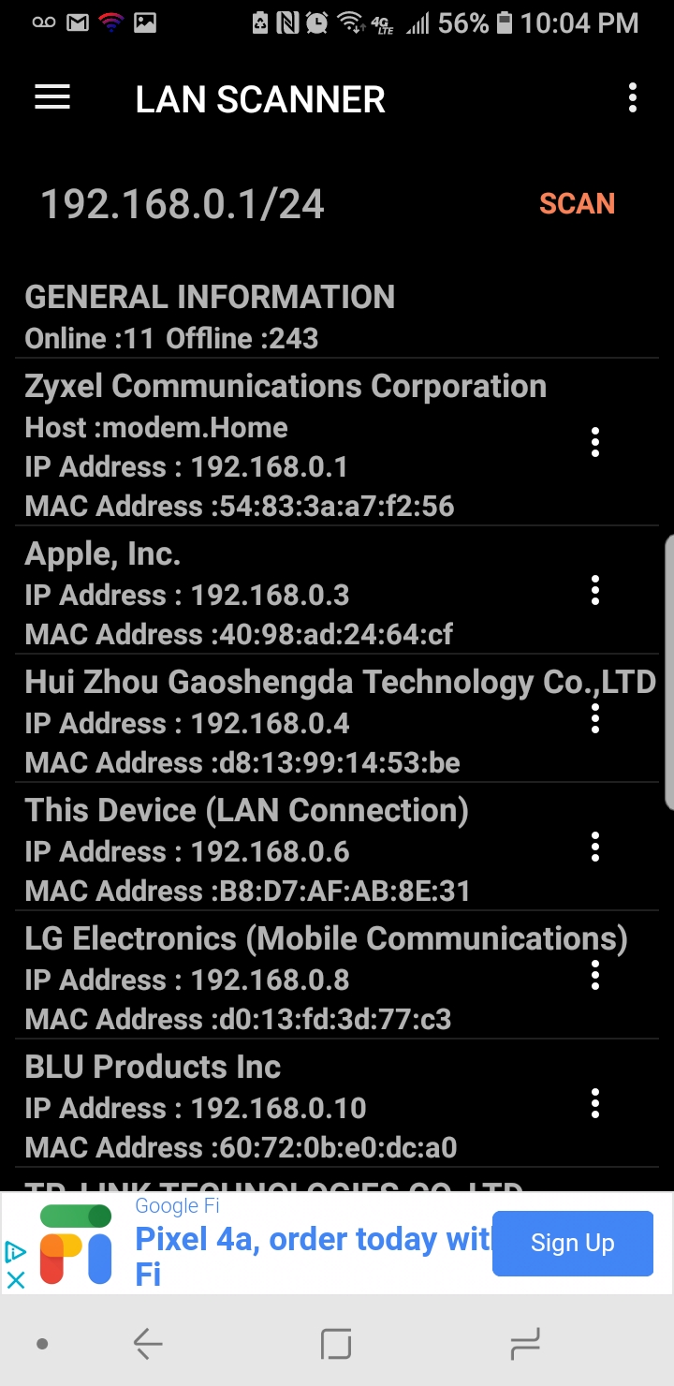
network manager (android)

Slide 7
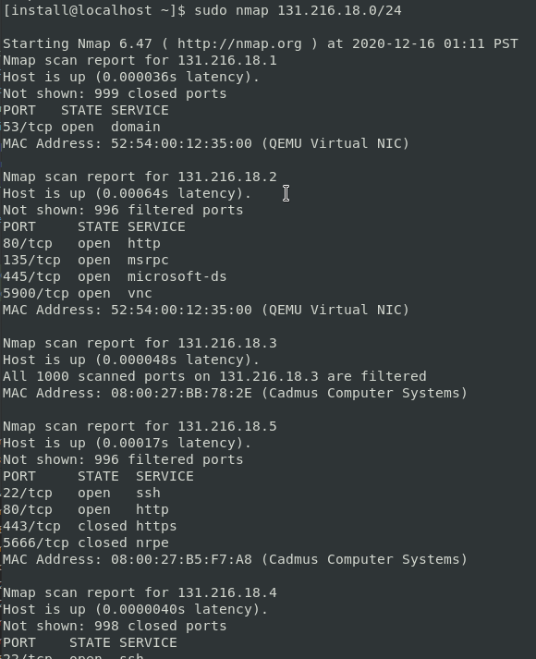
nmap scanner

Slide 8


prevention through education
teach small business owners how computer networks work while they are managing their own
help organizations be better informed about networks
Notes:
A PhD from Telecom Bretagne (Britannia) who specializes in Cyber Security Science, Wiem Tounsi conducted a research study in 2017 about how general knowledge of computer networks can help reduce the chances of a successful cyber attack.
In his study, he concluded that “having a standardized representation of threat information can improve the quality of technical threat intelligence (TTI)”.
Thus, we emphasized on helping small business owners and their organizations get basic computer network knowledge from our app.
To do this, we implemented tooltips for several things such as IP and MAC address.
These tooltips are designed to inform users what certain technical words mean, what they represent, how they work, and how they can be used in cyber attacks.
This way, users have a quick and simple way of getting basic yet solid knowledge for several of these key topics all within our app.
-----------------------------------------------------
This paper also looked into the importance of having an entire organization be well informed about vulnerabilities in their computer networks, which helped reduce that risk of a successful cyber attack even more significantly.
According to a study conducted on 1,066 people by the Pew Research Center in 2014 found that people over the age of 30 lacked the most basic knowledge of how internet and networks work (where only 1 in 3 people could explain what the internet was and how it worked).
And from Microsoft’s 2018 small business ownership statistics, we saw that the average age of a small business owner in the U.S. is 50.3 years.
As we can see here, this means that a lot of these small businesses are at high risk of falling prey to a cyber security attack.
While it would be free and simple for a small business to use an already existing network managing app (such as the one we showed earlier),
or other more in depth (and complex) tools such as EnMap or WireShark, the user must have a solid enough foundation to understand
and thus be able to manage the computer network.
Not to mention that in order to educate a whole organization decently on computer networks, it would cost the company a lot of time and money.
So, we decided to address this issue by implementing tooltips into our application.
next to each information display (for example an IP or a MAC address),
the user can find a little information icon that will educate a user enough
so that they can be better able to manage their network.
Reference 1: “A survey on technical threat intelligence in the age of sophisticated cyber attacks”
https://www.researchgate.net/publication/320027747_A_survey_on_technical_threat_intelligence_in_the_age_of_sophisticated_cyber_attacks
Reference 2: “What Internet Users Know about Technology and the Web”
https://www.pewresearch.org/internet/2014/11/25/web-iq/
Reference 3: “Small Business Ownership Statistics You Should Know”
https://www.microsoft.com/en-us/microsoft-365/business-insights-ideas/resources/small-business-ownership-statistics-know#:~:text=Small%20business%20ownership%20statistics%20from,the%20oldest%2C%20at%2054.1%20years.

Slide 9
features

Slide 10
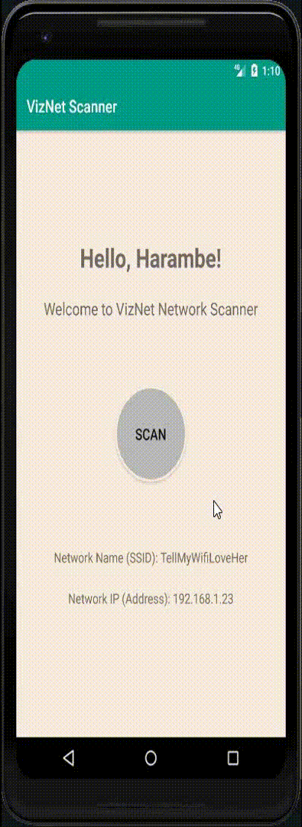
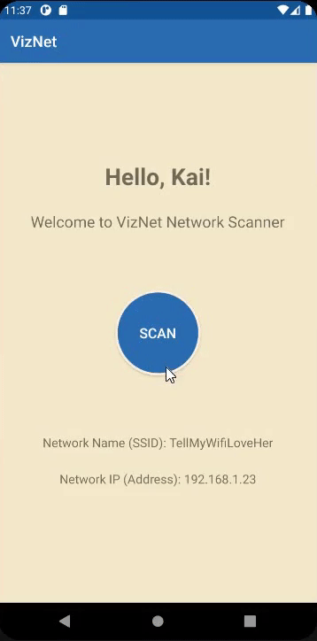
scan entire LAN
Iterates through possible IP’s and pings each.
Returns success Ex: 192.168.0.0/24 or 192.168.0.[0-255]
Notes:
NOTE: Network IP Address would be 192.168.1.1 with that IP
Can’t be .23

Slide 11

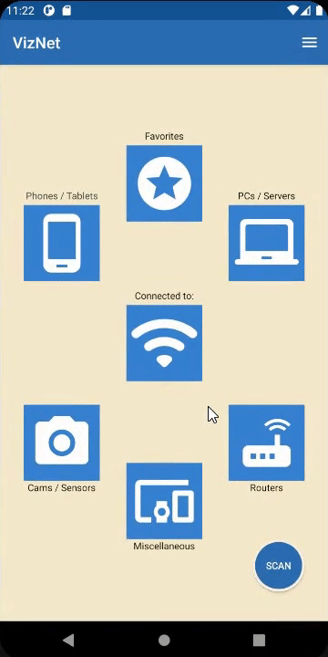
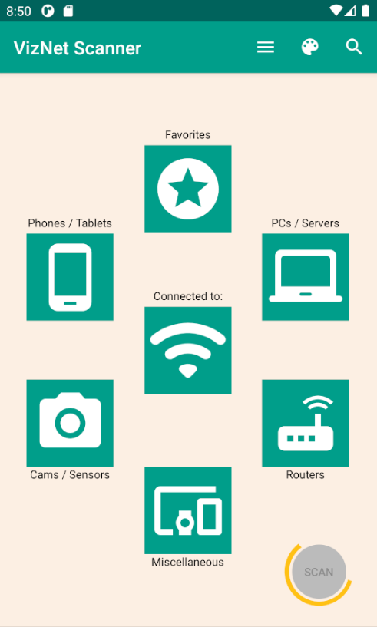
categorize devices
Categorized view (by Manufacturer ID)
Connected Network (direct)
Phones / Tablets
Computers (PCs) / Servers
Cameras / Sensors
Routers
Miscellaneous
Favorites (optional)
Rescans network (same as initial scan function)
Toolbar (left to right)
Navigation Menu
Color Palette
Search

Slide 12
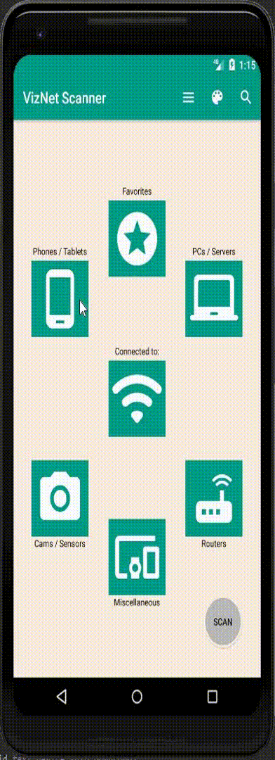
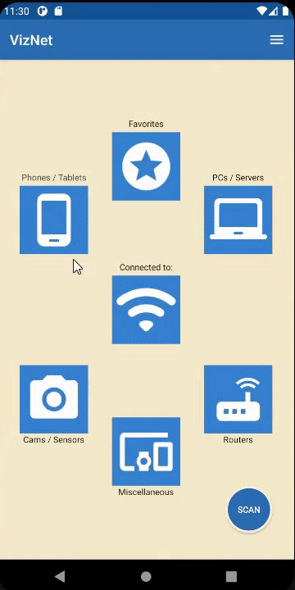
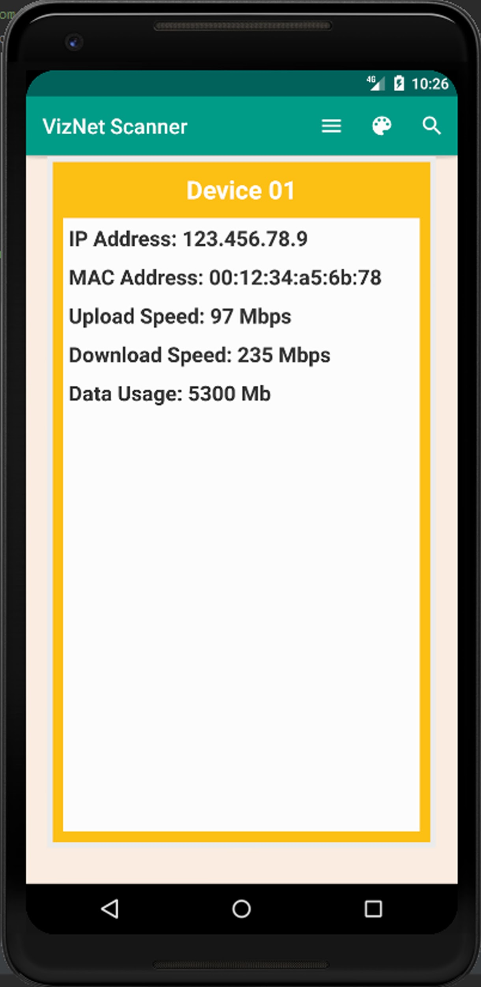
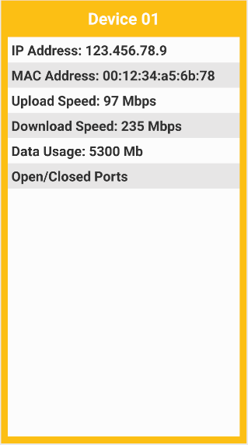
bring info to the user
device info:
IP Address
MAC Address
Open/Closed Ports
Educating users: tooltips display a helpful message about what users are looking at on a given line
Notes:
We wanted to show how our app displays specific device information on this slide
As with the previous screen, we wanted to list all of the devices in that category while making that list easy to read and understand
On this screen, we wanted to show more useful device information to users, sort of like an advanced options/specifications list
This is what the screen actually looks like in our prototype
So far, we have been able to get core information such as the IP, MAC, upload/download speeds, data usage, and a list of open and closed ports for that device
We do plan on displaying more information in the future

Slide 13




non-functional requirements
Android Studio 4.1
Java 8
XML
Android Lollipop SDK 21
Notes:
For our non-functional requirements, we chose to use Android Studio 4.1 to develop our product to provide ourselves with a learning experience as no team member had ever used the software before. The software uses the current version of Java 8 and XML. When choosing the Android SDK version 21, we wanted a large portion of android user to have access to our application and SDK 21 covers 99.8% of android users.

Slide 14
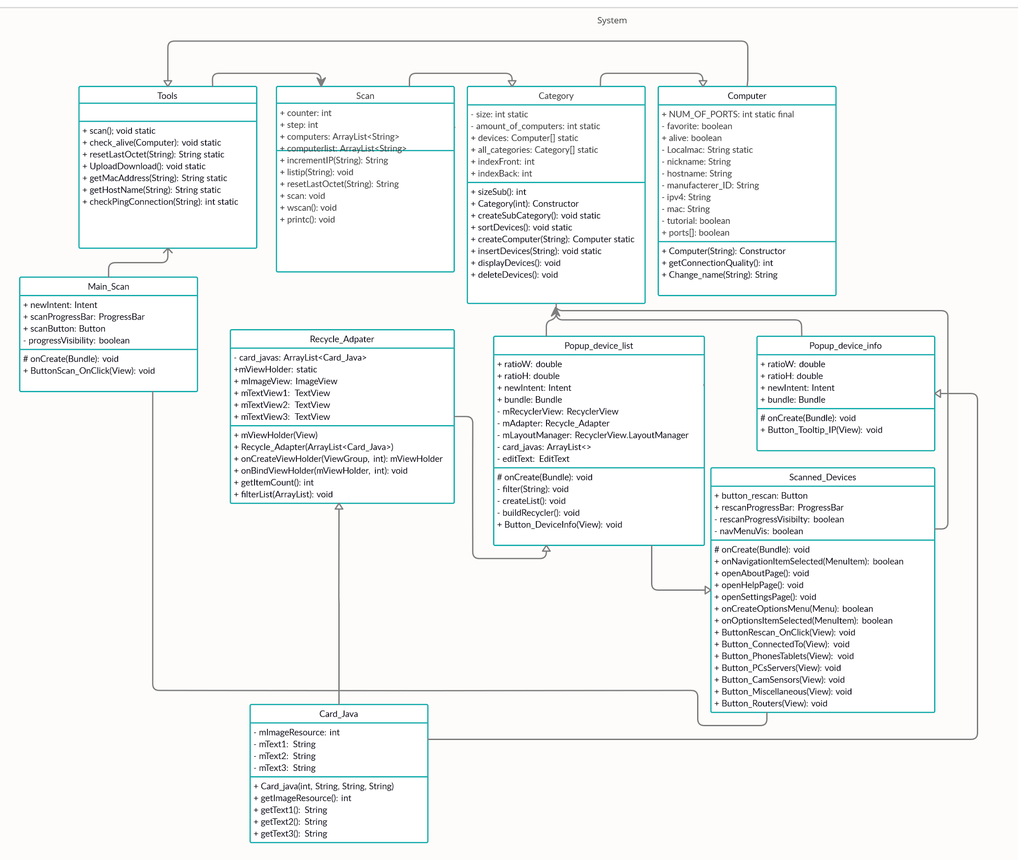
UML

Slide 15
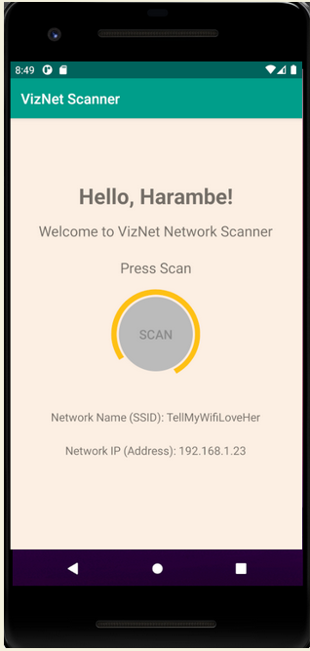
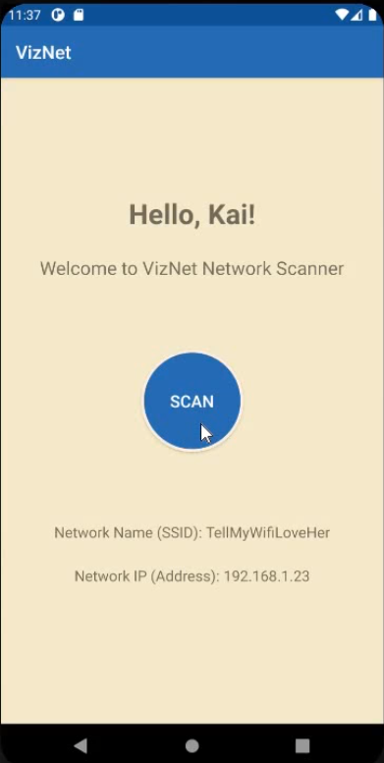
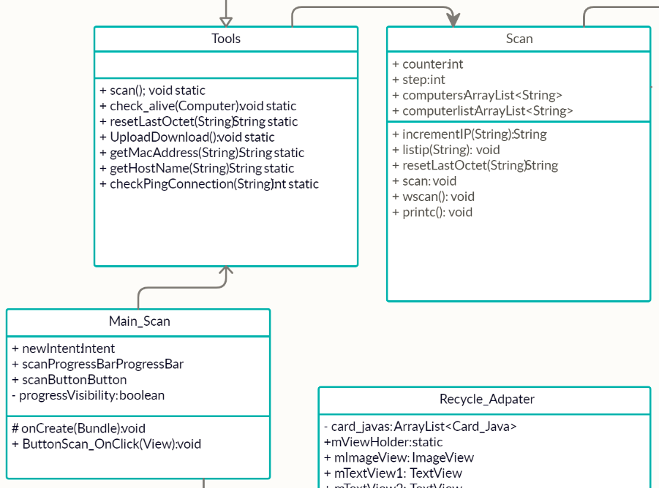
tools | utility class

Slide 16
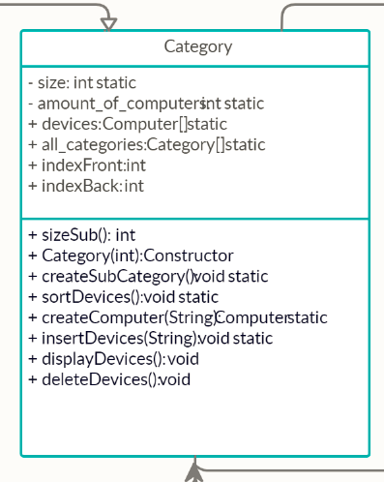
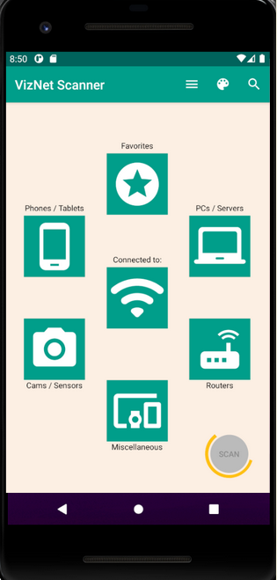
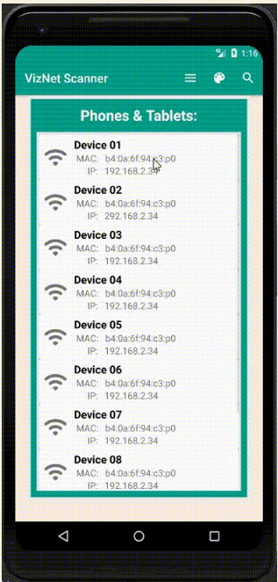
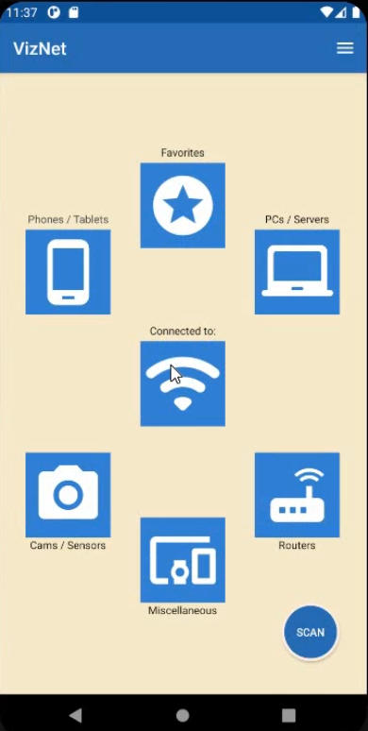
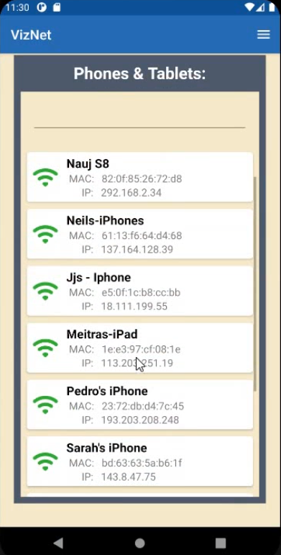
category

Slide 17
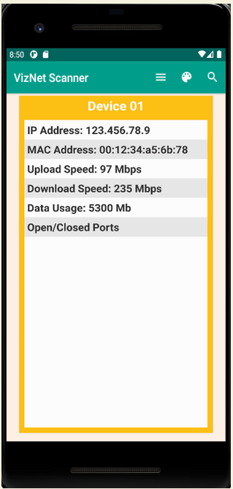
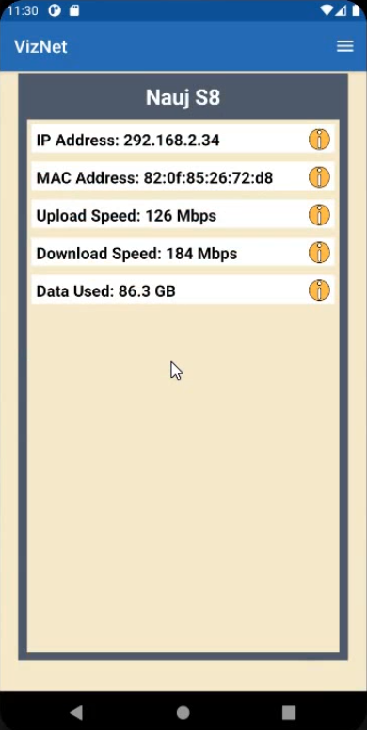
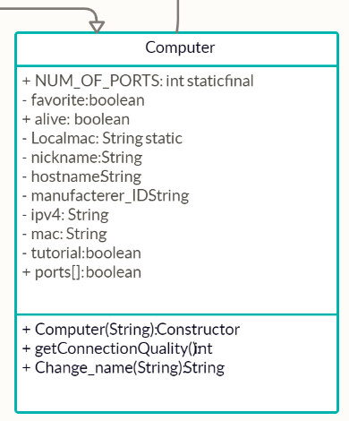
computer

Slide 18
Live Demo

Slide 19
conclusion

Slide 20
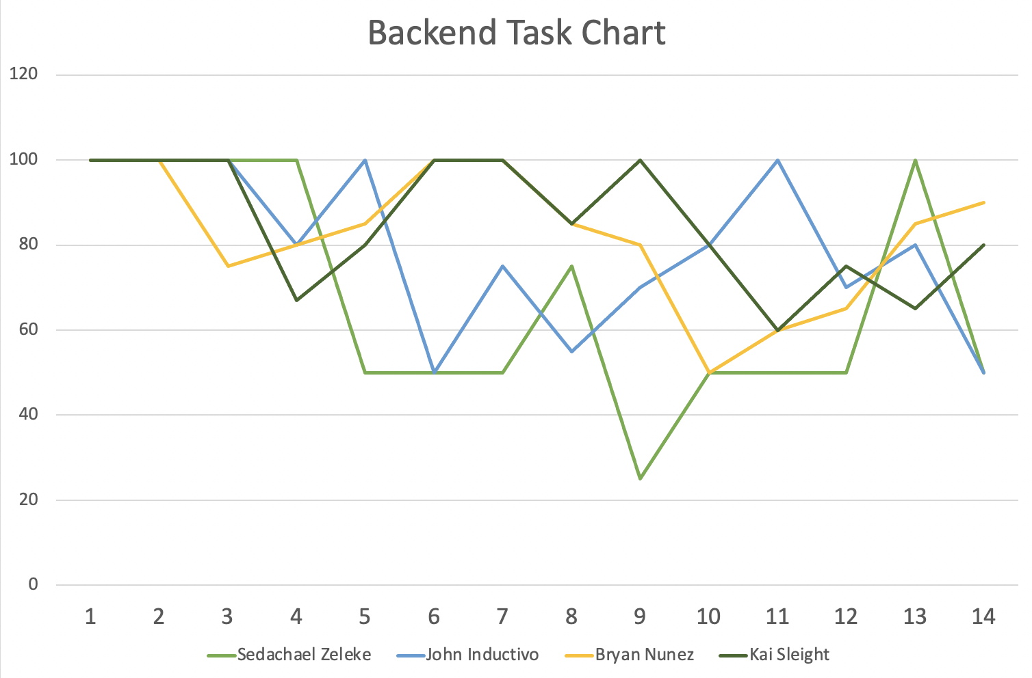
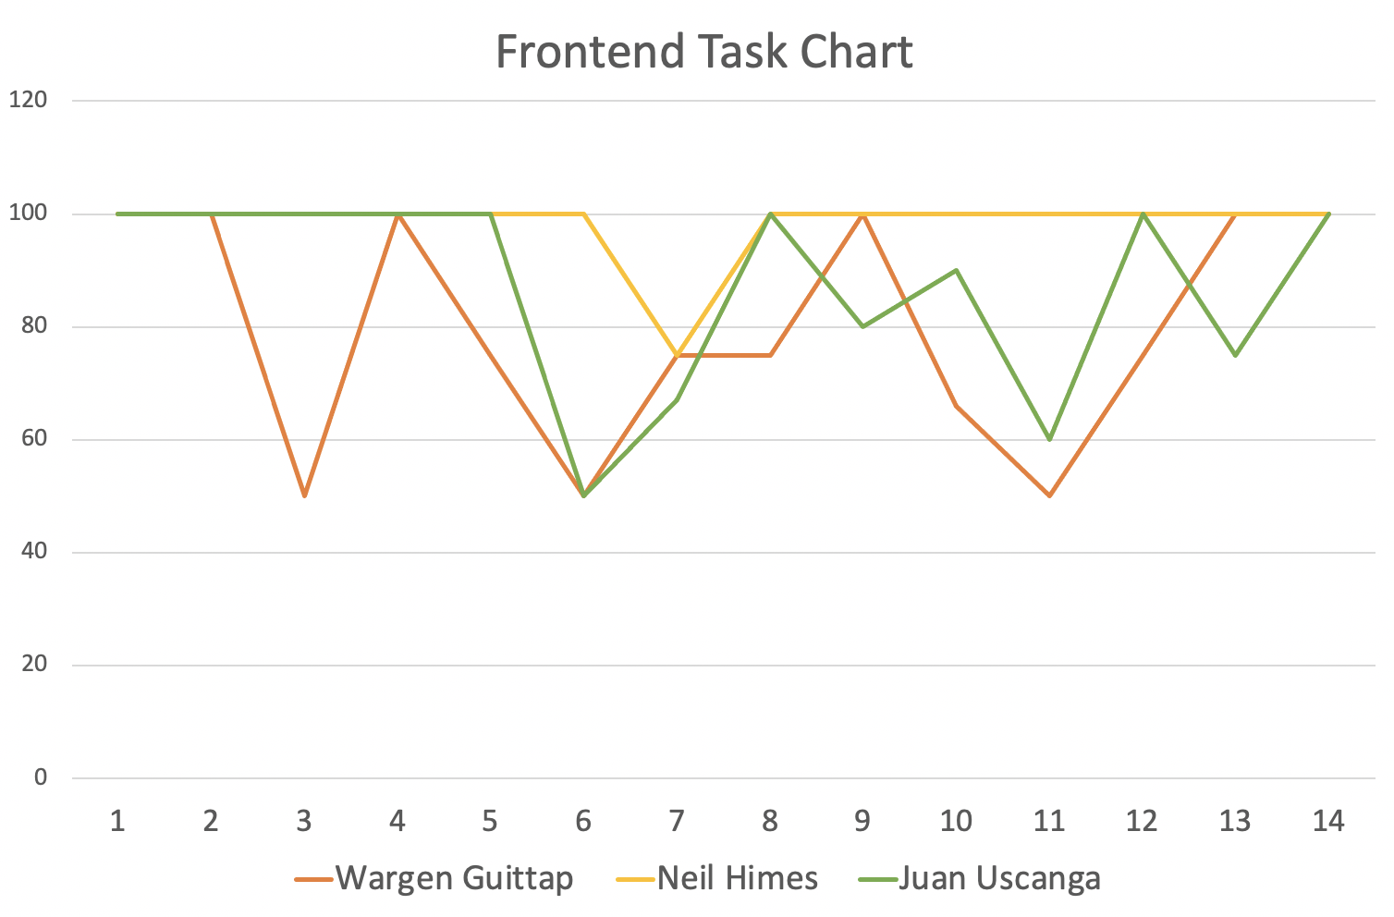
task chart

Slide 21
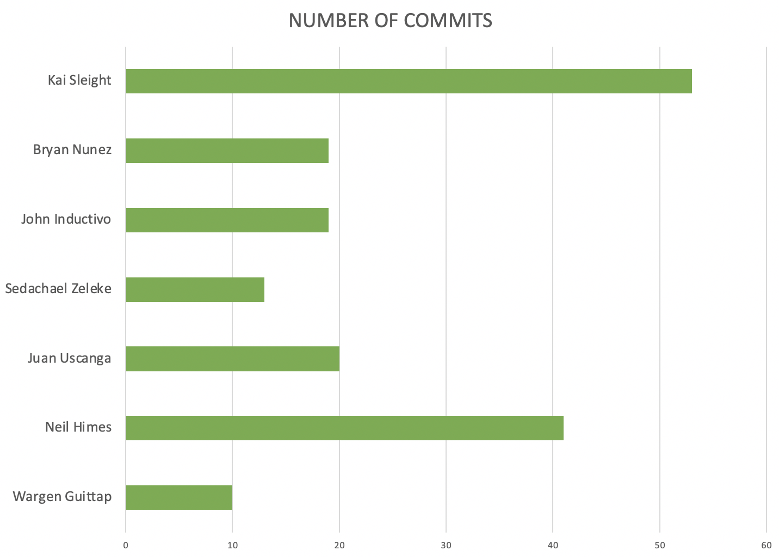
task commit chart

Slide 22
